Slide 1
Grocery Shopping Application
By
TAPAN.K.R

Slide 2
Problem Statement
To Develop a user- friendly grocery ordering platform that enhance customer shopping experience and streamlines grocery store operation
Target Audience:
Customers
Local Super Market
Delivery Staff

Slide 3
Key Modules
Customer Module:
Registration/Login, product browsing, shopping cart, order tracking.
Delivery Staff Module:
Delivery schedules, order statuses, optimized routes.
Admin Module:
Dashboard for managing platform activities ,order fulfillment, pricing updates., user and store management.

Slide 4
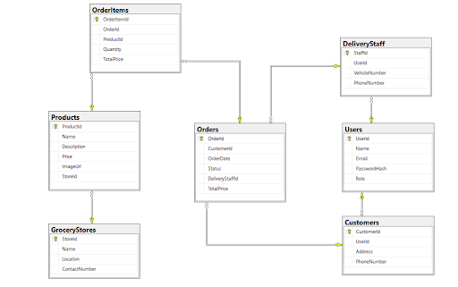
Block Diagram

Slide 5
Project Flow
Customer Registration and Login:
Secure account creation and login.
Browsing and Ordering Groceries:
Product search, filtering, and checkout process.
Order Processing by Stores:
order preparation and packing.
Delivery Coordination:
Delivery assignment, Payment at Delivery, and status updates.

Slide 6
Thank You

